Slide 1


mikekavouras
Notes:
Fast 2 hours
I didn’t just sit down at my computer and know what to type

Slide 2
React
JavaScript framework
Created by Jordan Walker, a software engineer at Facebook
Deployed to Facebook’s News Feed in 2011
Deployed on instagram.com in 2012
OSS in 2013
mikekavouras
Notes:
Deployed to production.
Shows Facebook’s commitment to React

Slide 3
React
Virtual DOM
React creates an in-memory data structure cache, computes the resulting differences, and then updates the browser’s displayed DOM efficiently.
mikekavouras

Slide 4
React
One-way data render
A component cannot directly modify any properties passed to it, but can be passed callback functions that do modify values.
mikekavouras

Slide 5
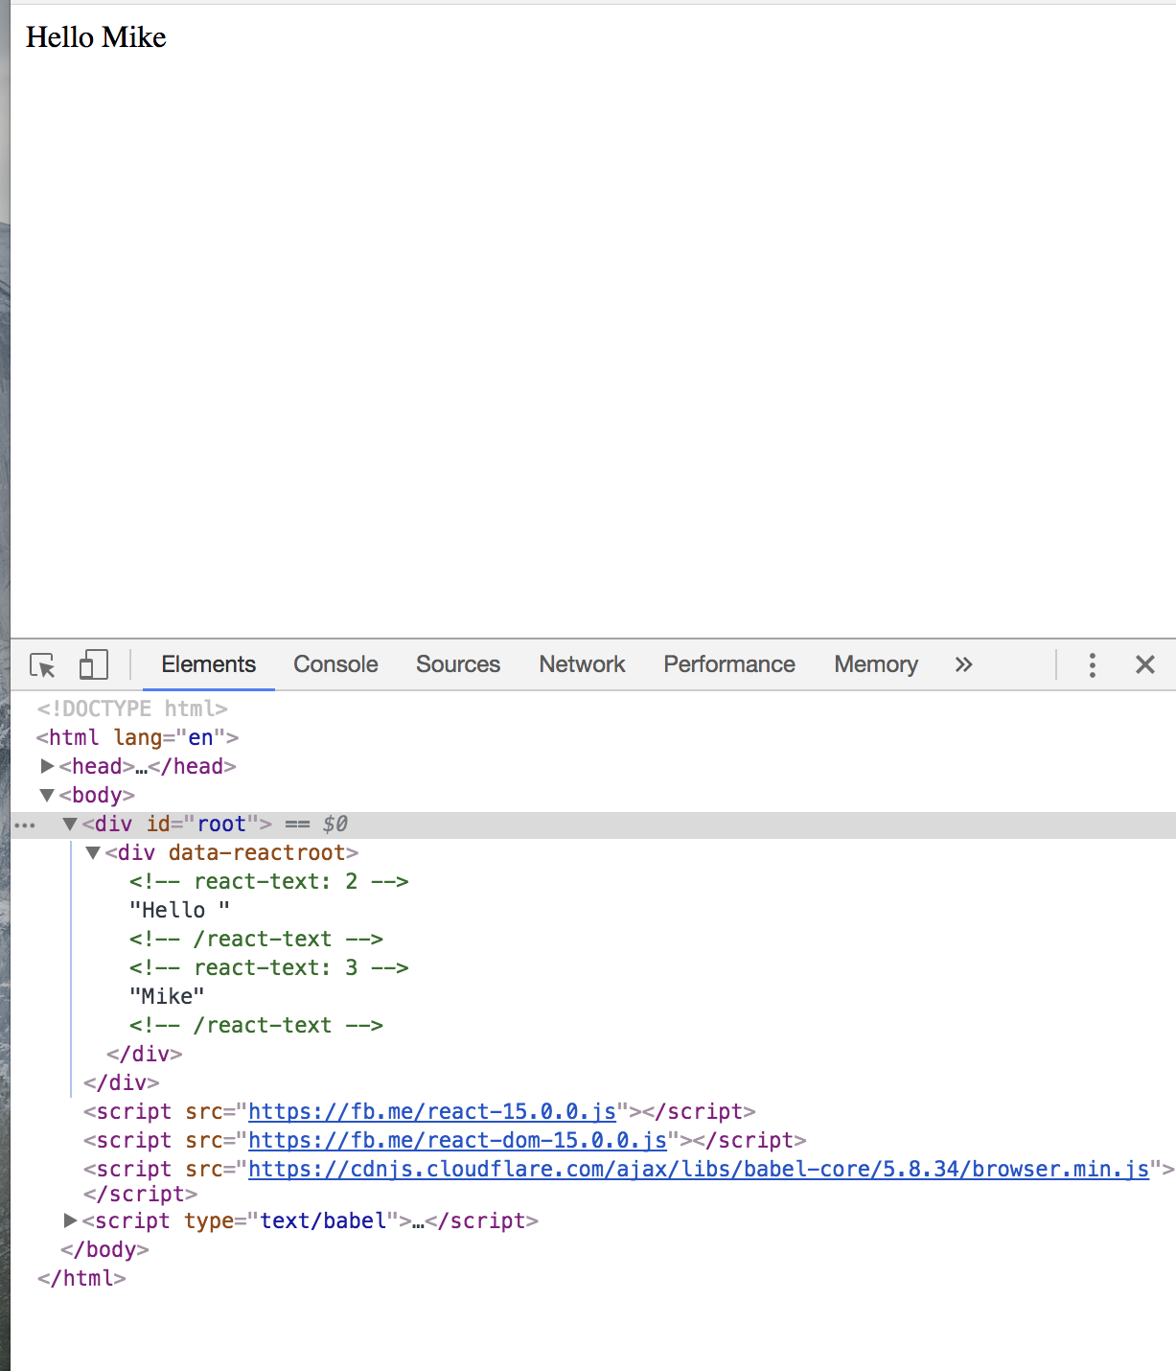
class HelloMessage extends React.Component { render() { return ( <div> Hello {this.props.name} </div> ); } } ReactDOM.render( <HelloMessage name="Mike" />, document.getElementById(“root”) );
Notes:
Stop for questions!

Slide 6
React (props)
https://facebook.github.io/react-native/docs/props.html
Most components can be customized when they are created, with different parameters. These creation parameters are called props.
mikekavouras

Slide 7
React (state)
https://facebook.github.io/react-native/docs/state.html
There are two types of data that control a component: props and state. props are set by the parent and they are fixed throughout the lifetime of a component. For data that is going to change, we have to use state.
mikekavouras

Slide 8
React (Life Cycle)
constructor()
componentWillMount()
render()
componentDidMount()
mikekavouras
Notes:
These methods are called when an instance of a component is being created and inserted into the DOM:

Slide 9
React (Life Cycle)
componentWillReceiveProps()
shouldComponentUpdate()
componentWillUpdate()
render()
componentDidUpdate()
mikekavouras
Notes:
An update can be caused by changes to props or state. These methods are called when a component is being re-rendered:

Slide 10
React (Life Cycle)
componentWillUnmount()
mikekavouras
Notes:
This method is called when a component is being removed from the DOM:

Slide 11
React Native
Built with React
Can be compiled into native code
Can be deployed to both iOS and Android
Business logic can be shared 1:1
mikekavouras

Slide 12
Tools (IDE)
Written with JavaScript
TypeScript https://www.typescriptlang.org/index.html
Flow https://flow.org
mikekavouras

Slide 13


Tools (IDE)
Android Studio
Xcode
mikekavouras

Slide 14
Let’s build an app!
mikekavouras

Slide 15
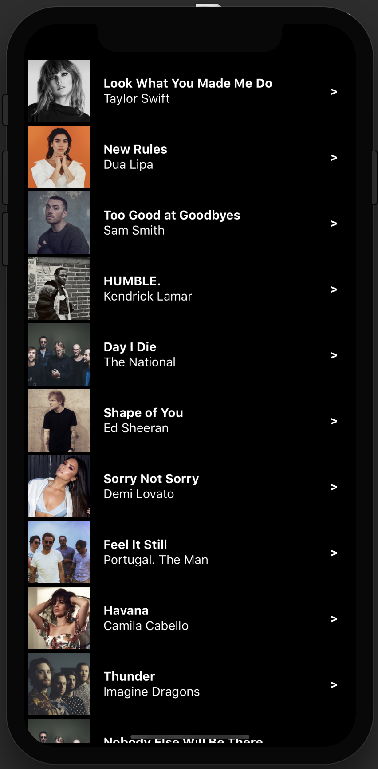

Slide 16
$ create-react-native-app Tunez
$ cd Tunez
$ yarn start
$ yarn run ios
mikekavouras
Notes:
Show style options

Slide 17
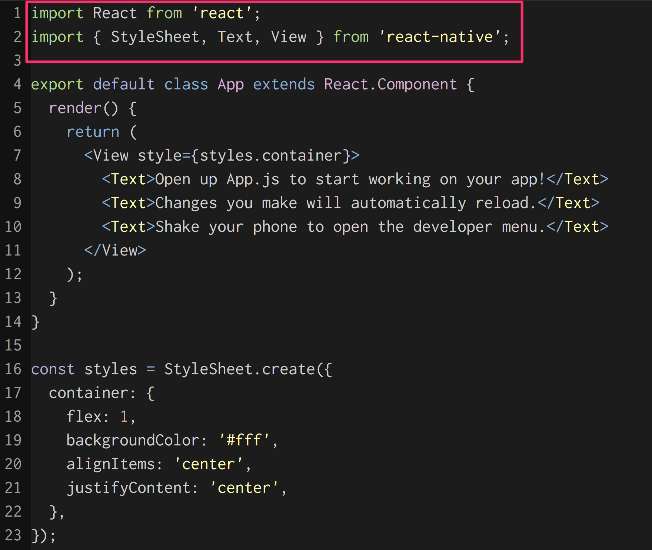

Slide 18
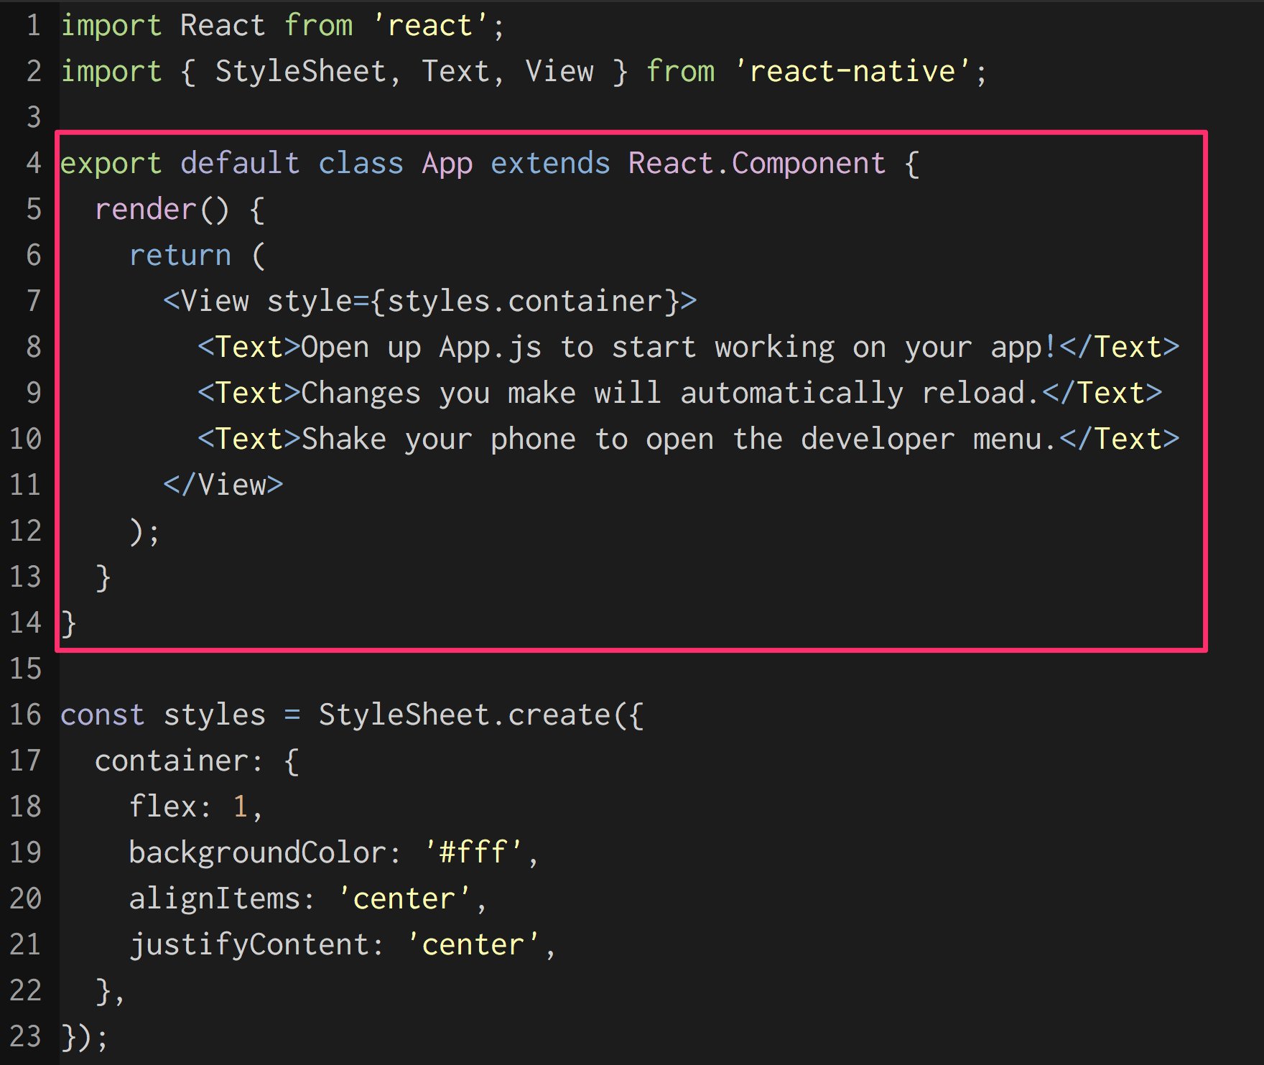

Slide 19
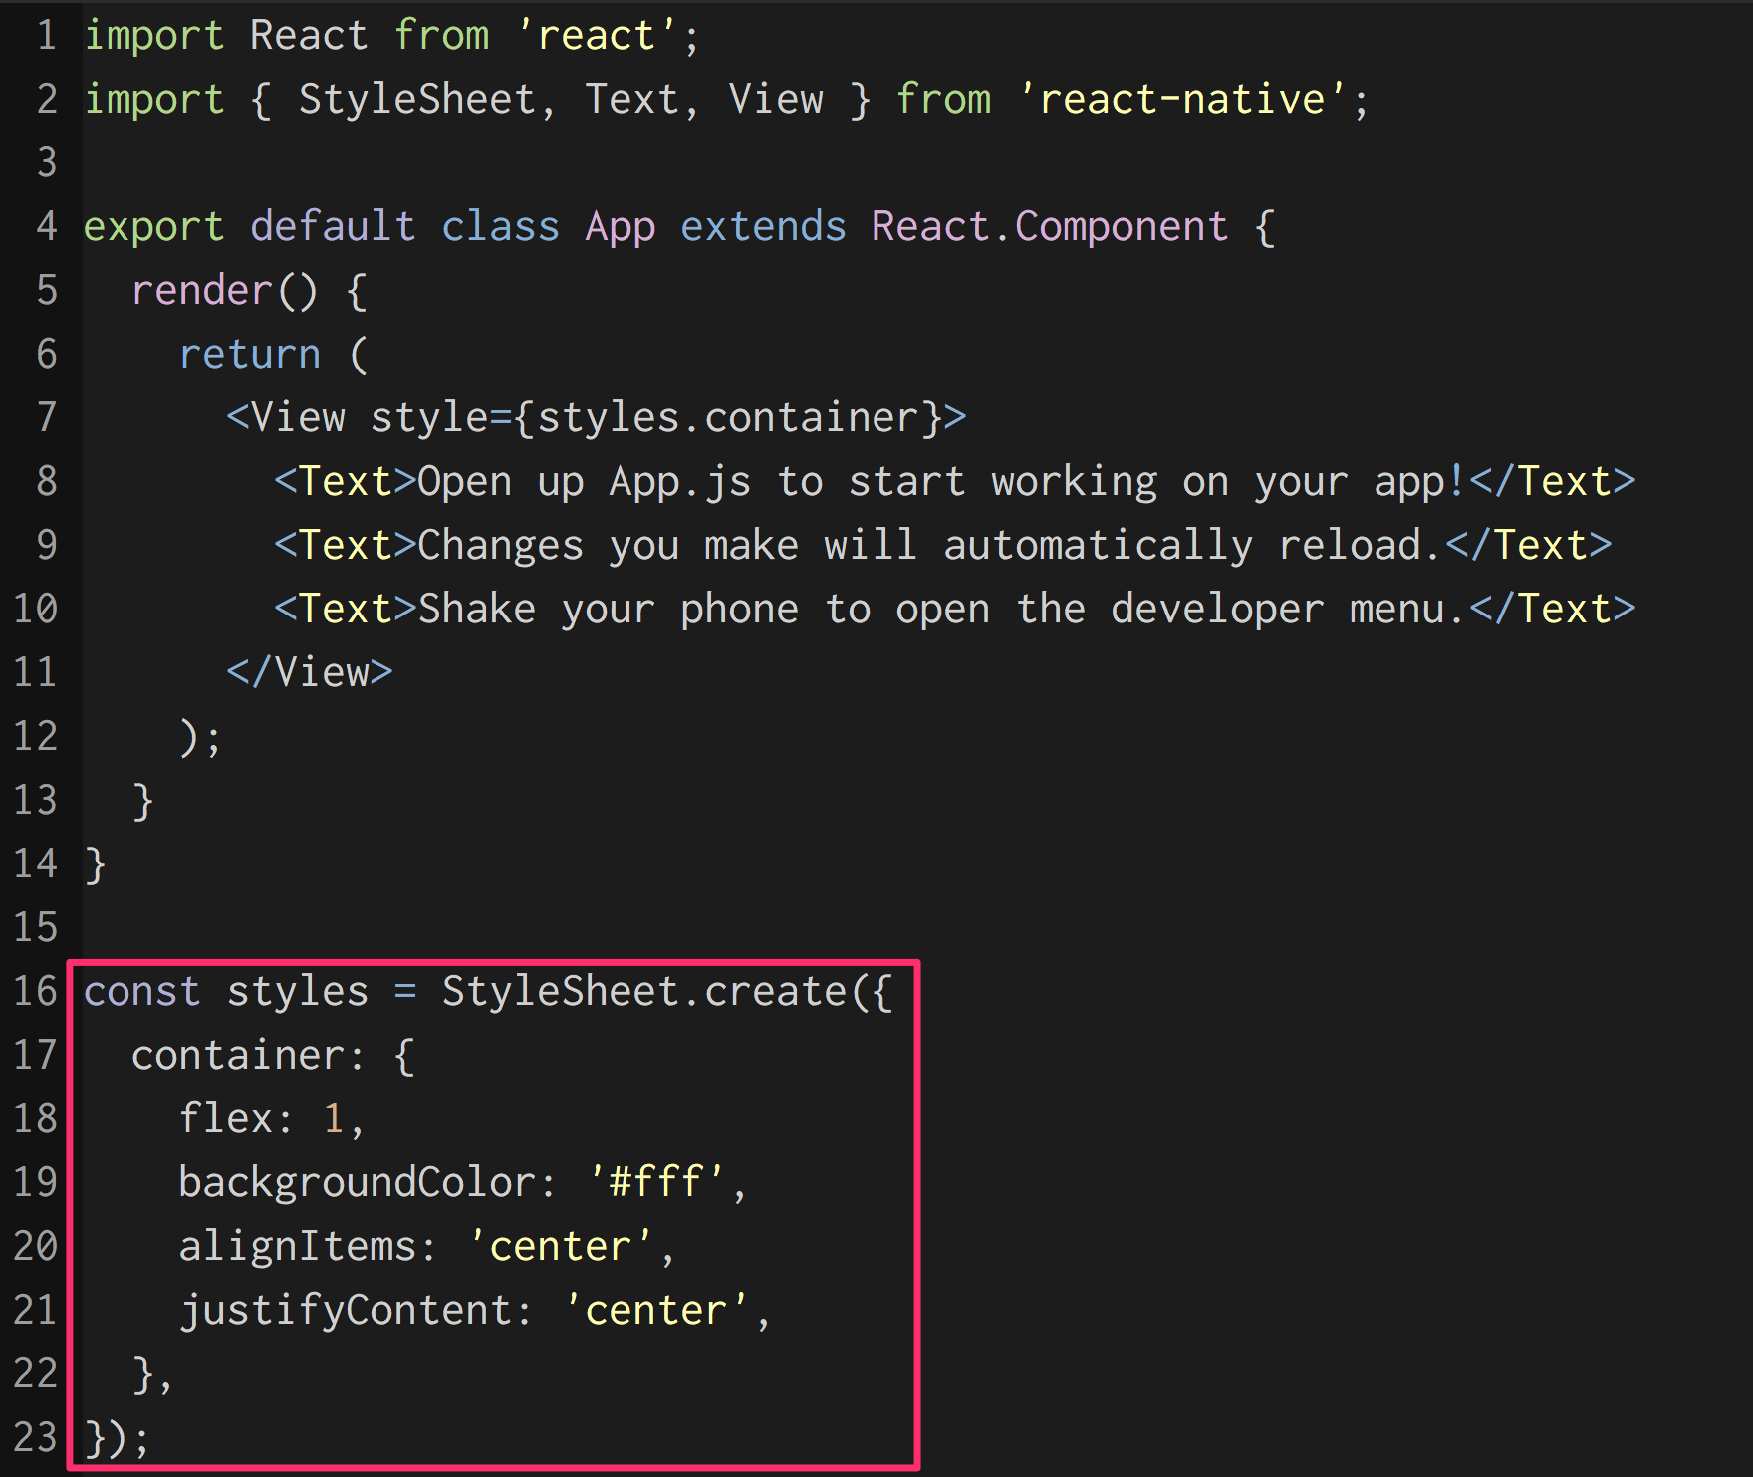

Slide 20
FlexBox
https://facebook.github.io/react-native/docs/flexbox.html
A component can specify the layout of its children using the flexbox algorithm. Flexbox is designed to provide a consistent layout on different screen sizes.
You will normally use a combination of flexDirection, alignItems, and justifyContent to achieve the right layout.
mikekavouras
Notes:
Take some time to play with layout

Slide 21
FlatList
https://facebook.github.io/react-native/docs/flatlist.html
A performant interface for rendering simple, flat lists, supporting the most handy features.
mikekavouras

Slide 22
Image
https://facebook.github.io/react-native/docs/image.html
A React component for displaying different types of images, including network images, static resources, temporary local images, and images from local disk, such as the camera roll.
mikekavouras

Slide 23
TouchableHighlight
https://facebook.github.io/react-native/docs/touchablehighlight.html
A wrapper for making views respond properly to touches. On press down, the opacity of the wrapped view is decreased, which allows the underlay color to show through, darkening or tinting the view.
mikekavouras

Slide 24
What’s Next?
Tappable Cells
Navigation
Audio
More/different content (last.fm api)
mikekavouras

